Slide 1
The Nervous System
Year 10 Psychology

Slide 2
Learning intentions
The nervous system enables us to respond to external changes. Information from receptors passes along nerves to the brain where the brain coordinates the response
The structures of the brain facilitate coordination of responses, including the central nervous system (brain, cerebellum, cerebrum, brainstem and spinal cord) and the peripheral nervous system
The central nervous system is protected by bone, meninges and cerebrospinal fluid
Receptors detect stimuli which include light, sound, changes in position, chemicals, touch, pressure, pain and temperature
Reflex actions are automatic and rapid, which involve sensory neurons, interneurons and motor neurons
The nervous system and the musculoskeletal system interact to provide coordinated actions of the body for walking and balance

Slide 3
The nervous system is divided into two parts
Nervous system: a communication network that controls all the systems of your body, such as the digestive and circulatory systems.
Central Nervous System (CNS): Made up of your brain and your spinal cord. The CNS receives information from all over the body, processes that information, and then sends out messages telling the body how to respond.
Peripheral Nervous System (PNS): Made up of the nerves that carry messages to and from the CNS and other parts of your body.

Slide 4
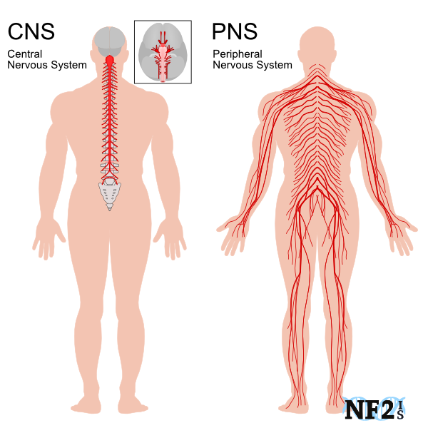

Slide 6
Central nervous system
All incoming messages from your environment and your responses to them are processed through the central nervous system. It is referred to as ‘central’ because it combines information from the entire body and coordinates activity across the whole organism.
The brain is encased in the skull while the spinal cord is protected with the vertebrae of our backbones.
The brain has three layers of membrane to protect it called meninges.
Both the spinal cord and the brain are surrounded in a fluid called cerebrospinal fluid (CFS), which provides nutrients to the neurons and acts as a shock absorber.

Slide 7
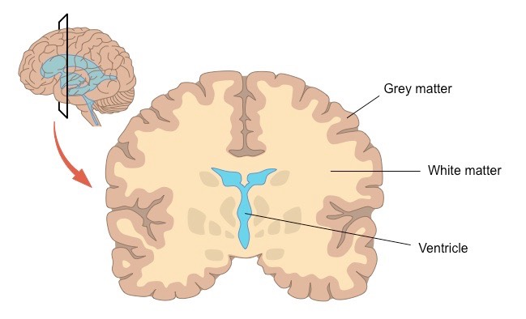
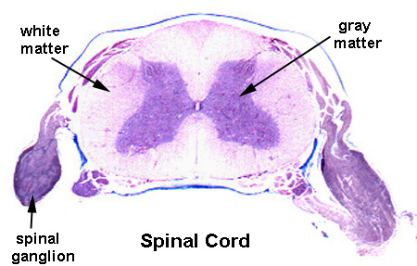
Central nervous system cont.
Grey Matter comprises neuron cell bodies and their dendrites.
White Matter refers to the areas of the CNS which host the majority of axons (part of the nerve cells).
In the brain, white matter is buried under the grey surface, carrying signals across different parts of the brain. In the spinal cord, white matter is the external layer surrounding the grey core.

Slide 8
Peripheral nervous system
The peripheral nervous system is a large system made up of all the nerves outside the central nervous system. The peripheral nervous system carries information between the central nervous system and the rest of the body, such as the limbs and organs.
It is divided into 2 parts:
Somatic NS
Autonomic NS

Slide 9
Somatic and autonomic control
The somatic nervous system controls voluntary skeletal muscle movements, such as waving or reaching out to take an object.
The autonomic nervous system controls involuntary actions, which happen without our conscious control. This includes heartbeat, digestion, respiration, salivation and perspiration. The autonomic nervous system maintains your body’s internal environment (homeostasis). It has two parts: the sympathetic division which controls the body’s response at rest and the parasympathetic division which controls the body’s reaction during perceived threat.

Slide 10
Autonomic control
Parasympathetic: Rest and Digest – Uses acetylcholine (neurotransmitter)
Sympathetic: Fight or flight – Uses noradrenaline (neurotransmitter)

Slide 11
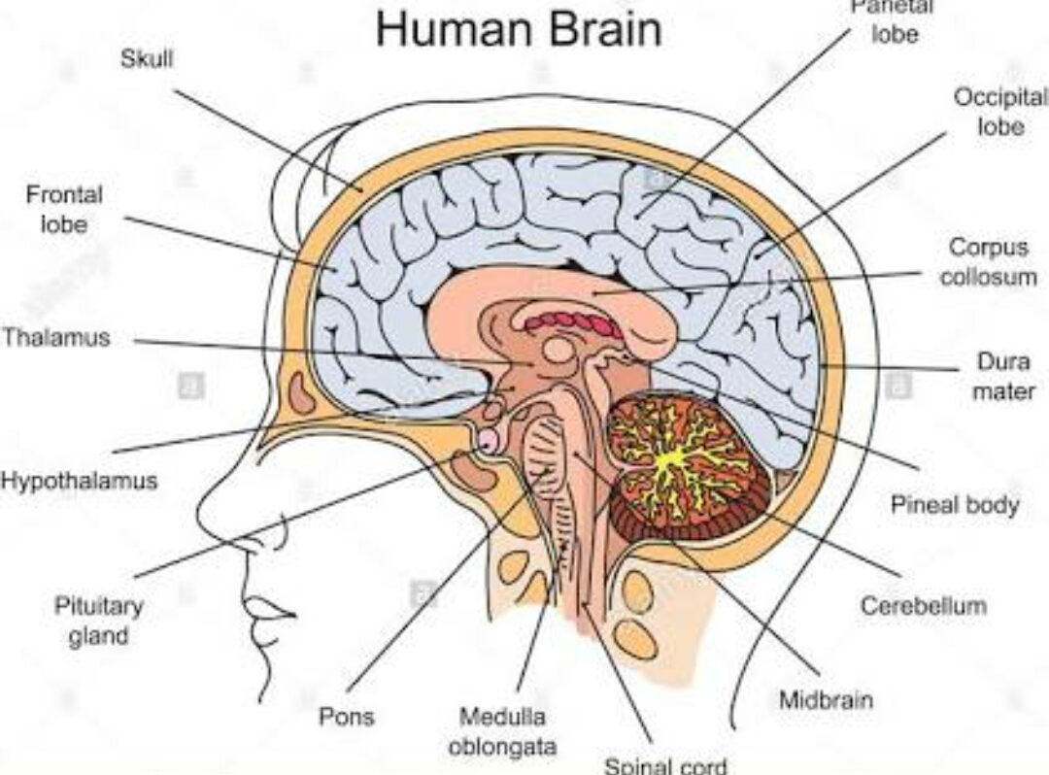
The brain
The human brain contains about 100 billion neurons, and has an average volume of 1200–1400 mL.
The brain controls and regulates body functions.

Slide 12
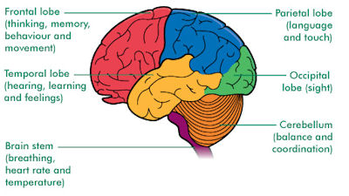
Lobes of the brain

Slide 13
The cerebrum
It occupies more than 80% of the brain
Controls your conscious thoughts and the intentional (voluntary) movements of everybody part.
Also receives sensory messages from all parts of your body such as the sounds you hear and the light you see.
Made up of two parts - right and left cerebral hemispheres. When you are performing an intended and voluntary action such as walking or hitting a ball, the right hemisphere controls the left side of your body and the left hemisphere controls the right side of your body

Slide 14
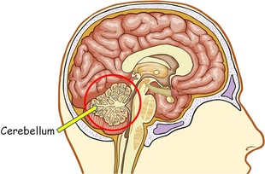
The cerebellum
Located at the base of the cerebrum, above the pons
Responsible for movement, balance and coordination
People who suffer from damaged cerebellums often struggle to keep their balance and maintaining proper muscle coordination.

Slide 15
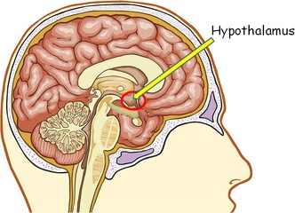
The hypothalamus
The hypothalamus is a small area of your brain. It’s very important in controlling the balance of your bodily functions. It controls the release of hormones from the pituitary gland.
While it’s very small, the hypothalamus plays a crucial role in many important functions, including:
Releasing hormones
Regulating body temperature
Maintaining daily physiological cycles
Controlling appetite
Regulating emotional responses

Slide 16
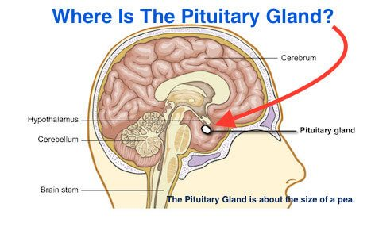
Pituitary gland
The pituitary gland is a part of your endocrine system.
Its main function is to secrete hormones into your bloodstream. These hormones can affect other organs and glands, including your thyroid, reproductive organs and adrenal glands.

Slide 17
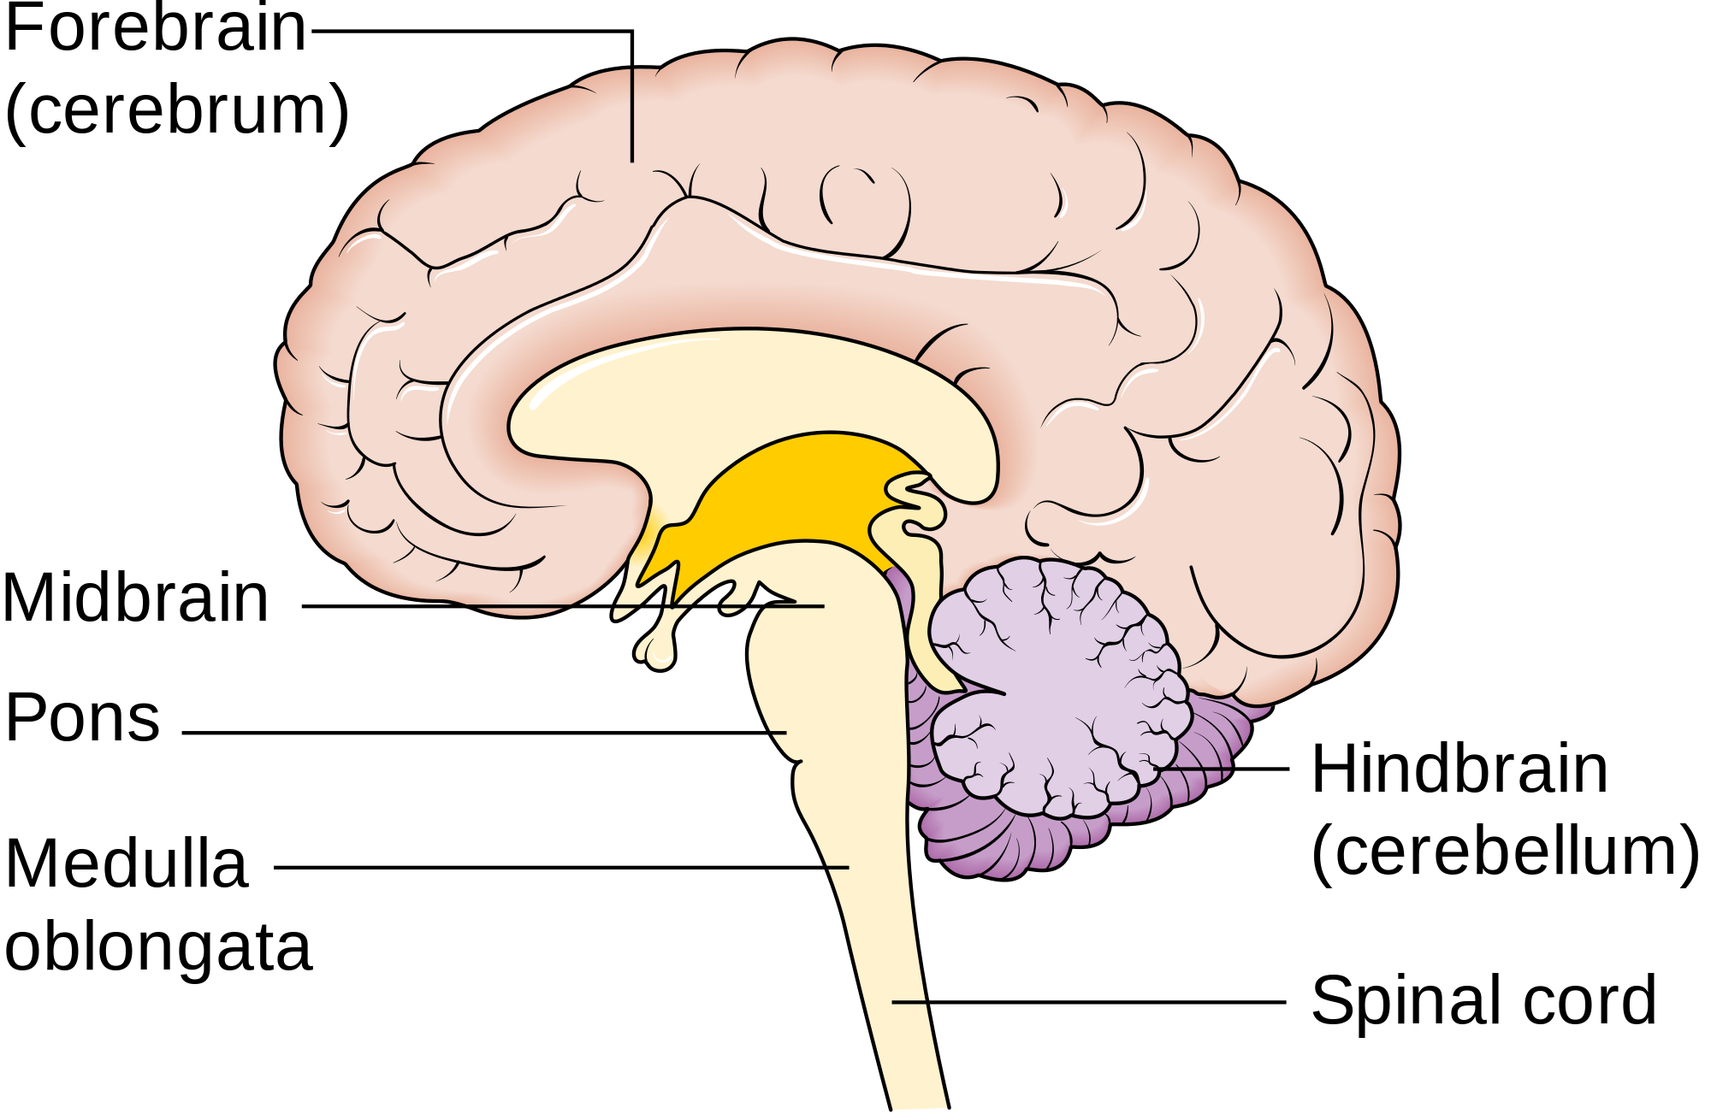
The brain stem
The brain stem sits mostly inside the brain.
The brain stem is made up of three major parts
– the medulla,
- the pons
- and the midbrain.
The medulla is at the bottom of the brain stem and controls automatic functions, such as respiration (breathing) and digestive system activities.
The pons assists in some automatic functions, such as breathing, and also controls sleep.
The midbrain contains areas that receive and process sensory information, such as movement and vision.

Slide 18
Receptors
Receptors in our bodies detect stimuli which include light, sound, changes in position, chemicals, touch, pressure, pain and temperature. Receptors detect stimuli and then produce nerve pulses. Receptors can be all over the body or concentrated in sense organs. If the nerve impulse produced by a receptor are conducted to the cerebrum we become consciously aware of the stimulus.
Mechanoreceptors: responds to touch and sound
Chemoreceptors: responds to chemical substances
Photoreceptors: responds to light
Thermoreceptor: responds to temperature changes

